Slide 1

AI-Based Dynamic Pricing Optimization System
A comprehensive machine learning solution transforming retail pricing strategies through intelligent automation and data-driven decision making

Slide 2
MILESTONE 1
Business Understanding & Strategic Foundation
Dynamic Pricing Challenge
Project Objectives
Traditional static pricing fails to respond to market dynamics, leading to missed revenue opportunities and inefficient inventory management.
Develop an AI system that automatically adjusts prices based on real-time market conditions while respecting business constraints.
Market volatility and competition
Maximize revenue and profitability
Customer demand fluctuations
Improve inventory turnover
Inventory optimization needs
Maintain competitive positioning

Slide 3

MILESTONE 1
Dataset Preparation & Quality Assurance
01
02
Data Collection
Validation Checks
Comprehensive retail pricing dataset gathered from multiple sources including historical transactions and inventory records
Rigorous column validation ensuring data integrity, consistency, and completeness across all attributes
03
Readiness Confirmation
Final dataset verified and approved for analysis, meeting all quality standards and project requirements

Slide 4
MILESTONE 1
Key Performance Indicators
1
2
3
4
Revenue Lift
Profit Margin
Conversion Rate
Inventory Turnover
Measures the percentage increase in total revenue compared to baseline static pricing strategies
Tracks net profit improvement while balancing competitive pricing and operational costs
Monitors the effectiveness of pricing on customer purchase decisions and transaction completion
Evaluates how efficiently pricing strategies accelerate product movement and reduce holding costs

Slide 5
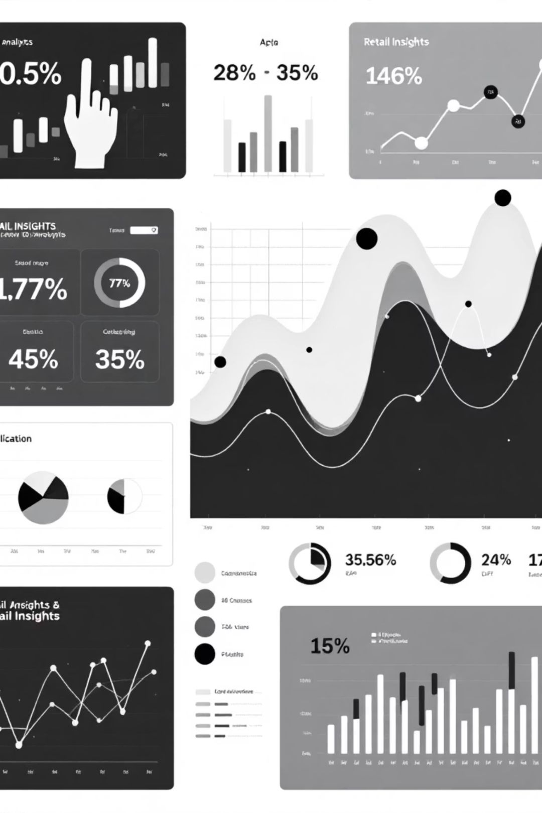
MILESTONE 2
Exploratory Data Analysis: Understanding Patterns
EDA Purpose
Behavioral Insights
Systematic examination of data to uncover hidden patterns, relationships, and structural characteristics that inform model development
Analysis reveals how customers respond to price changes across different product categories, seasons, and market conditions
Trend Identification
Detection of temporal patterns, cyclical behaviors, and anomalies that impact pricing effectiveness and demand forecasting

Slide 6
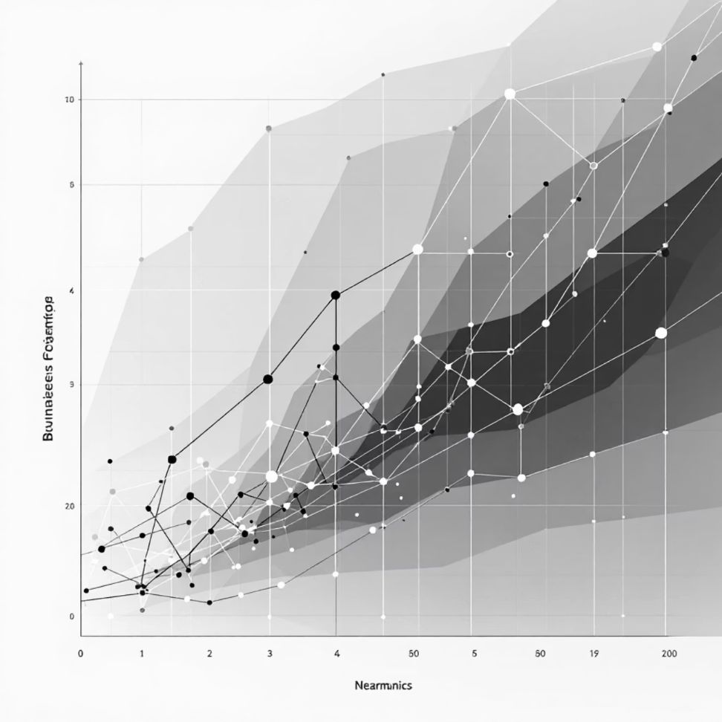
MILESTONE 2
Critical Data Relationships & Insights
Price-Demand Dynamics
Strong inverse correlation observed: higher prices typically reduce demand, but elasticity varies significantly by product category and customer segment.
Revenue Optimization
Sweet spot identified where price increases maximize revenue without excessive demand reduction. Profit margins show non-linear relationship with volume.
Inventory Impact
Low inventory levels correlate with reduced sales opportunities, while excess inventory suggests suboptimal pricing strategies requiring adjustment.

Slide 7
MILESTONE 2
Data Quality Assessment
Correlation Analysis
Missing Values
Outlier Detection
Identified key predictive variables and multicollinearity issues. Strong correlations found between price, demand, and seasonal factors.
Detected systematic gaps in inventory records and sporadic missing prices. Imputation strategies developed for different missing data patterns.
Identified extreme pricing anomalies and unusual demand spikes. Determined which represent errors versus legitimate market events requiring retention.

Slide 8




MILESTONE 3
Feature Engineering: Enhancing Predictive Power
Time-Based Features
Created day-of-week, month, season, and holiday indicators to capture temporal pricing patterns and demand cycles
Lag Features
Generated historical price and demand lags enabling models to learn from past patterns and sequential dependencies
Rolling Averages
Computed moving averages for demand smoothing and trend identification across multiple time windows

Slide 9

MILESTONE 3
Milestone 3 – Feature Creation
Time-Based FeaturesCreated day-of-week, month, season, and holiday indicators to capture temporal pricing patterns and demand cycles
Lag FeaturesGenerated historical price and demand lags enabling models to learn from past patterns and sequential dependencies
Rolling AveragesComputed moving averages for demand smoothing and trend identification across multiple time windows

Slide 10

MILESTONE 3
Milestone 3 – Data Readiness
Key Indicators Defined
1
Developed and integrated critical metrics such as stock-to-sales ratios, gross margin return on investment (GMROI), and customer lifetime value (CLTV) to provide comprehensive business insights for dynamic pricing.
Robust Imputation Strategies
2
Implemented advanced techniques for handling missing data, including mean, median, mode imputation for numerical data, and sophisticated predictive models for categorical gaps, ensuring dataset completeness and integrity.
Curated & Validated Dataset
3
Consolidated all processed features and cleaned data into a unified, machine learning-ready dataset, meticulously validated for consistency, accuracy, and format compliance, paving the way for model training.

Slide 11
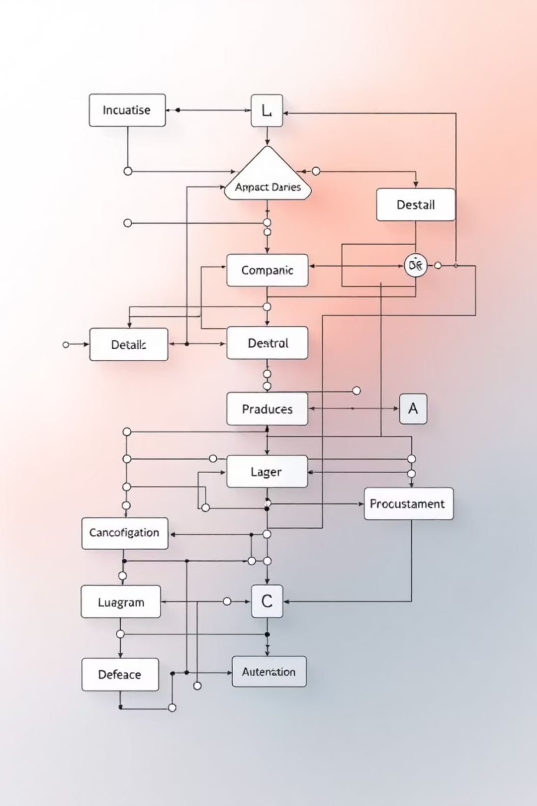
MILESTONE 4
Milestone 4 – Rule-Based Design
Inventory-based pricing rules
Time-based pricing adjustments
Business logic implementation

Slide 12
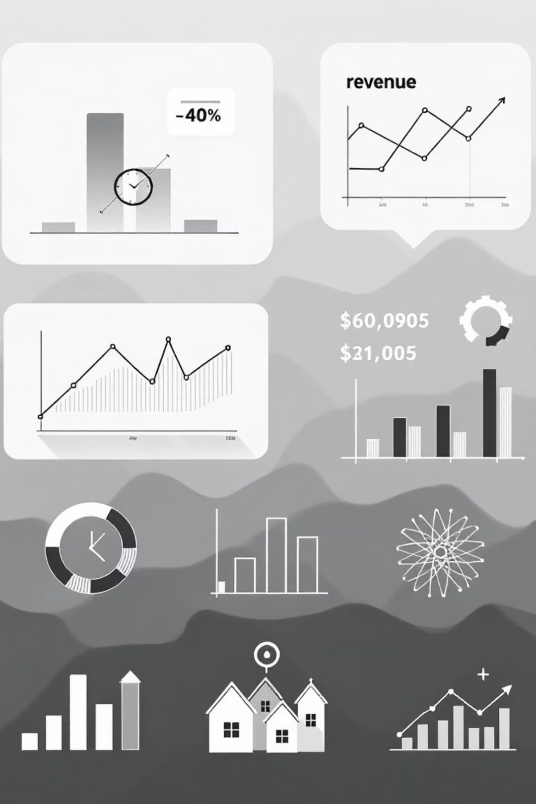
MILESTONE 4
Milestone 4 – Rule-Based Evaluation
1
2
Static vs rule-based pricing
Revenue lift analysis
Comparative analysis of performance between traditional static pricing and the newly implemented rule-based dynamic pricing system.
Quantification of the increase in revenue directly attributable to the rule-based pricing adjustments and strategies.
3
Validation of rule logic
Verification of the effectiveness and accuracy of the underlying business rules and their impact on market conditions.

Slide 13

MILESTONE 4
Milestone 4 – Learnings
Benefits of rule-based pricing
Limitations
Need for ML approach

Slide 14

MILESTONE 5
Milestone 5 – ML Model Development
XGBoost and LightGBM models
1
Demand prediction strategy
2
Time-based train-test split
3

Slide 15

MILESTONE 5
Milestone 5 – ML Pricing Simulation
1
2
Predicted Demand Integration
Algorithmic Price Generation
Leveraged machine learning-generated demand forecasts to inform optimal pricing levels, ensuring prices reflect anticipated market behavior and customer response.
Developed an algorithm that dynamically adjusts prices based on real-time data inputs, including inventory levels, competitor pricing, and demand elasticity, to maximize revenue.
3
Robust Backtesting
Employed rigorous backtesting procedures using historical data to evaluate the effectiveness and profitability of the dynamic pricing model before live deployment, identifying areas for refinement.

Slide 16


MILESTONE 5
Milestone 5 – ML Results & Impact
Static vs Rule-Based vs ML Pricing
Revenue Improvement Observed
Comparative analysis demonstrating the superior performance of the ML-driven dynamic pricing model over static and rule-based approaches.
Quantifiable uplift in overall revenue attributed directly to the intelligent adjustments made by the machine learning pricing algorithm.
Key Performance Gains
Significant improvements in key metrics including inventory turnover, profit margins, and customer satisfaction due to optimized pricing strategies.

Slide 17

MILESTONE 6
Milestone 6 – Backend Deployment
Best model saved
FastAPI backend implementation
The final, best-performing machine learning model has been successfully saved and serialized, ready for integration into the production backend system.
A high-performance and scalable backend API has been meticulously implemented using FastAPI, designed to serve real-time predictions from the saved ML model.
API testing using Swagger UI
Rigorous API testing was conducted leveraging Swagger UI, ensuring all endpoints are fully functional, robust, and correctly integrated for seamless data flow and model inference.

Slide 18
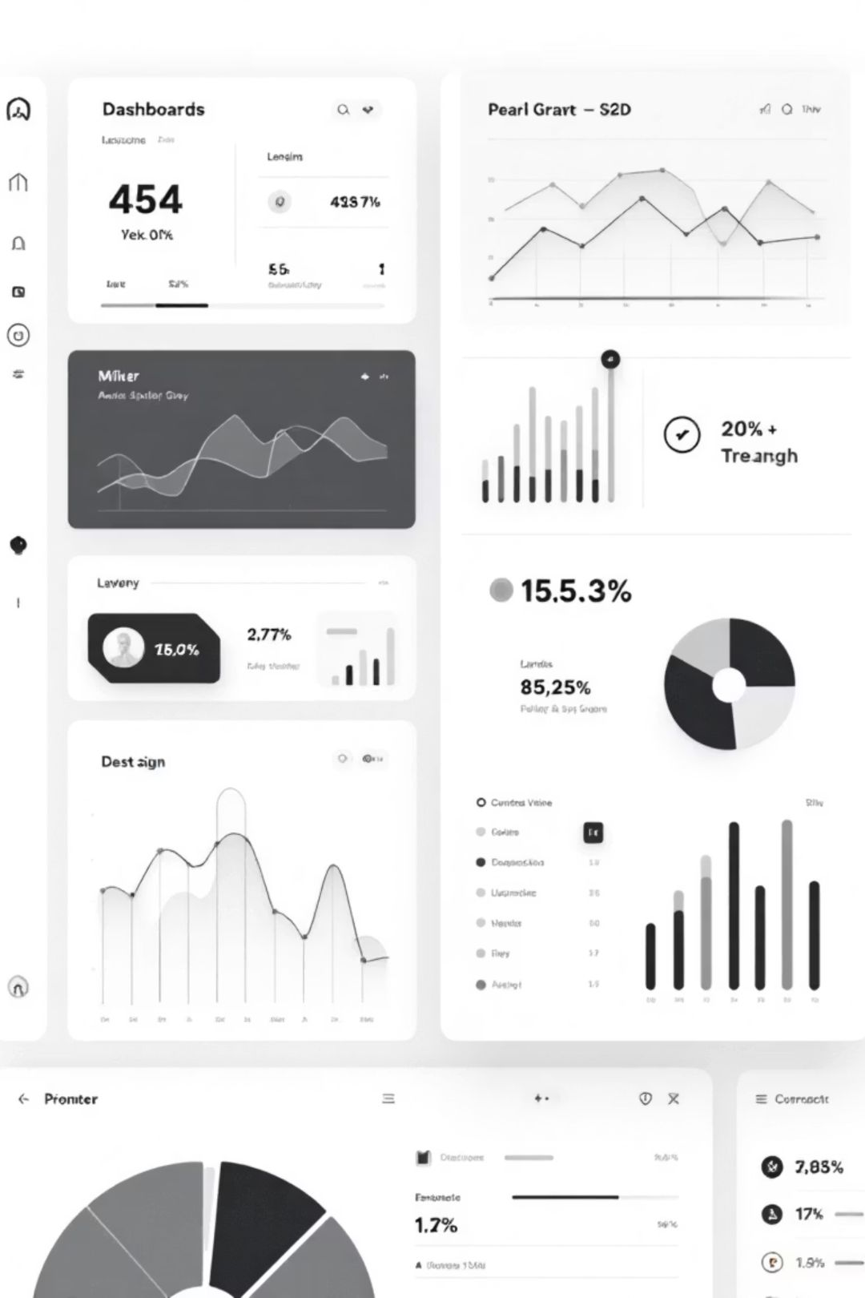
MILESTONE 6
Milestone 6 – Dashboard Development
React.js Dashboard Development
1
Designed and implemented an intuitive and responsive user interface using React.js to visualize data and interact with the dynamic pricing model.
Input Features and Price Output
2
Integrated controls for users to input various features (e.g., product, date, quantity) and display the corresponding optimal price generated by the ML model.
Backend–Frontend Integration
3
Established robust API endpoints and data flow mechanisms to ensure smooth and efficient communication between the React.js frontend and the FastAPI backend.

Slide 19
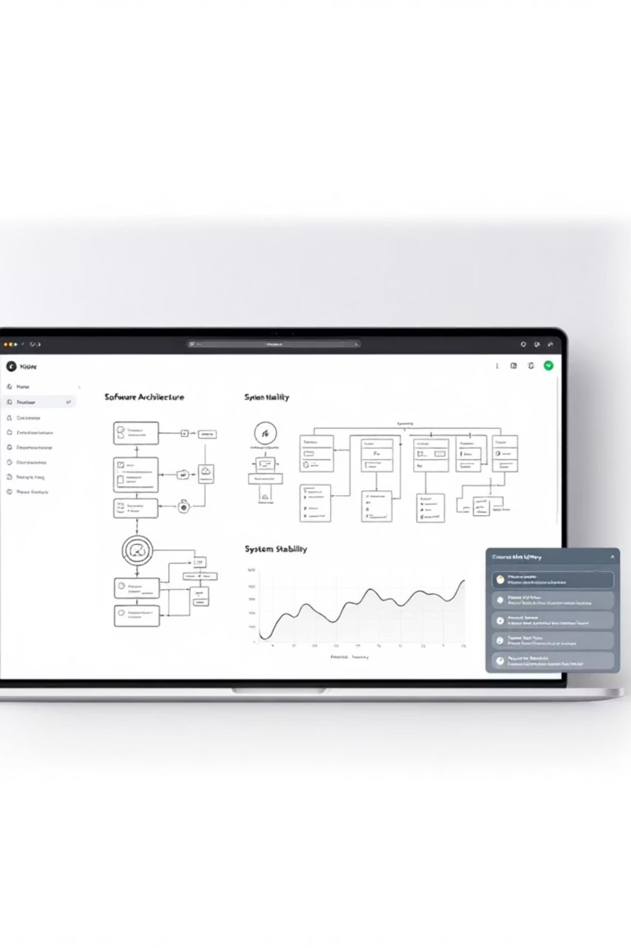
MILESTONE 6
Milestone 6 – Execution & Documentation
1
2
Local Execution Stability
Comprehensive README
Validated the model's performance and stability in local environments, ensuring consistent results before deployment to production.
Developed a detailed README document outlining setup instructions, usage guidelines, API endpoints, and troubleshooting tips for easy team collaboration and future maintenance.
3
Real-World Usability
Tested the integrated system with simulated real-world scenarios to confirm its practical effectiveness and user-friendliness for optimal business application.

Slide 20

CONCLUSION
Thank You & Future Outlook
We sincerely appreciate your time and engagement in understanding the capabilities of our AI-Based Dynamic Pricing Optimization System.
We are excited about the sustained success this system will bring. We welcome your questions and are eager to discuss next steps to further empower your business.

